Slide 1
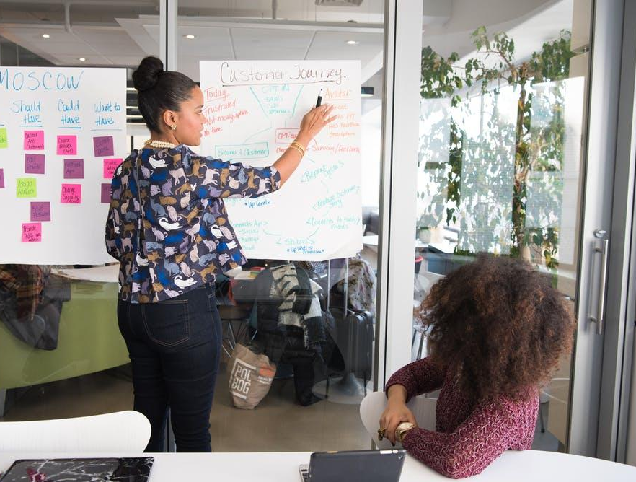
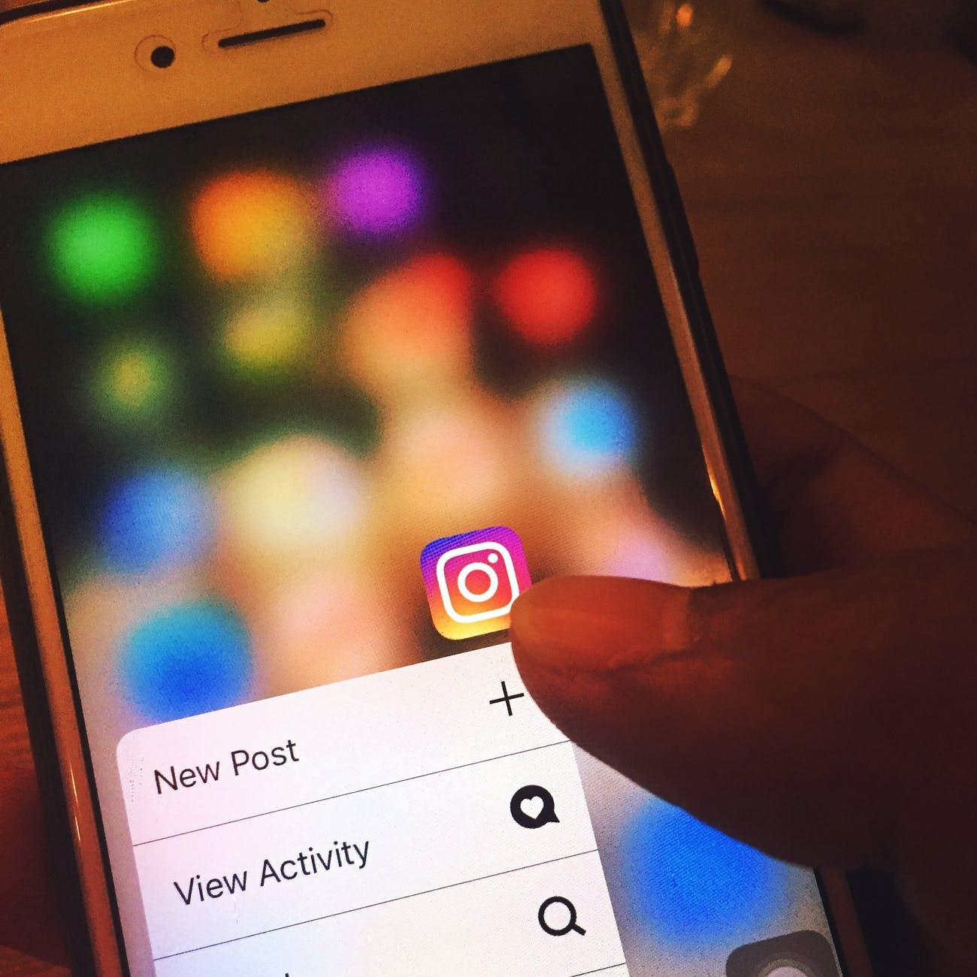
IG/FB MARKETING SUCCESS ESSENTIALS DURING COVID-19
BY SAC BLACK BIZ

Slide 2
Today, You’ll Learn:
How to set up for success using the Assessment Form
What Instagram is and what makes its community unique.
How to install and get started on Instagram.
How to create a presence on Instagram.
Understand the importance of your business's presence on Insta/Fb, especially on mobile.
Learn how to post content that engages your customers.

Slide 3
Today, You’ll Learn:
Understand the importance of creating a mobile presence for your business.
Recognize the different ways to communicate with customers from your Page, whether it's one-on-one or through a variety of posts.
Understand the tools available to manage and measure how well your Page is doing.

Slide 4
After Today, You’ll Be:
Fb Blueprint certified in Intro To Instagram E-learning Course (Beginners)
Fb Blueprint certified in Intro To Fb Pages E-learning Course (Beginners).

Slide 5
Ready, Set, Wait!

Slide 6
Assessment Form: Setting Up For Success

Slide 7
Let’s Go!

Slide 8
Intro To Insta

Slide 9
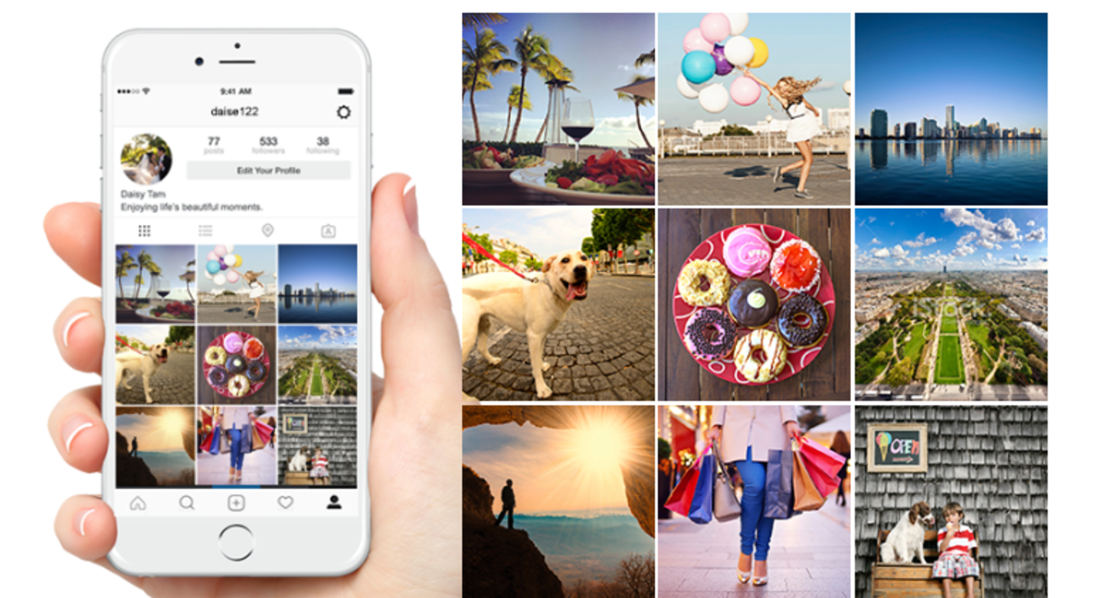
Intro To Insta
The Instagram community: a mix of people and businesses.
Instagram’s official mission: Strengthen relationships through shared experiences.
Insta is 1 of the fastest growing communities online today: More than 1B Insta accounts worldwide; over 500 million accounts are active every day.

Slide 10
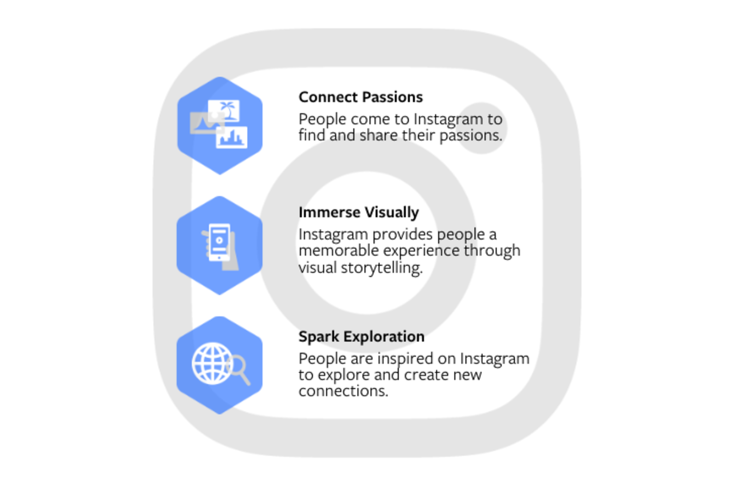
Reasons to establish your business Insta account

Slide 11
Reasons to establish your business Insta account
Tell your story
Create an organic account to engage and build relationships over time with people interested in your business
Be found
IG organic accounts are the best way to be found, and people can find your business when they search on IG.
Communicate directly with your customers
Respond directly to potential customers’ comments + DMs.

Slide 12
How to create your Insta (Biz) account
Download the Instagram app.
Open your cell, go to Apple Store/Google Play
Search for Instagram and hit download
Tap Sign Up. Enter your email address, and tap Next, or tap Log-In with Facebook to sign up with your Facebook account.
If you register with your email, create a username and password. Fill out your profile information and then tap Done.
If you register with Facebook, you'll be prompted to log into your Facebook account if you're currently logged out.
It is recommended that you create your account using the IG mobile app, not in a desktop browser.

Slide 13
Growing Your Audience
How? Create STRONG content
What is STRONG content? High-quality, On-brand, that people want to see (Relevant).
Creating strong content also increases like the likelihood that your account will be discovered by non-followers via the Explore tab or News tab.
Instagram uses an algorithm to bring users to new content they might be interested in by scrolling explore.
People see a feed of the accounts they follow and posts they liked, including yours.

Slide 14
Growing Your Audience
You can also grow your audience by making Instagram part of your day-to-day business and marketing:
Post a sign at your retail location(s) with your IG account, or share it in communications like emails/postcards
Announce your IG account on other platforms (Facebook or Twitter), or provide a link on the homepage of your website

Slide 15
How to connect w/ the right people on Insta
Choose QUALITY over quantity
Avoid overusing hashtags, creating contests and giveaways, or using third parties to buy followers (this attracts people less likely to be your ideal target audience).
Focus on your BUSINESS objective
Building followers is not a true business objective and should never be your main business goal. As the IG community creates more content and as people follow more brands, your business's share of voice will change over time.

Slide 16
How to connect w/ the right people on Insta
Be authentic
Share creative that represents your brand's unique personality and attracts like-minded followers.
(For inspiration, find, follow and interact with other relevant accounts through the Search & Explore tab.)
You can also get inspiration by following the IG blog.

Slide 17
Intro To Fb Pages

Slide 18
Building Your Mobile Presence
Your Page is your business’ identity on Facebook.
Here are a few things you should add to your Page to make it helpful:
Useful details about your business
A list of your products, services, or available jobs
A call-to-action button to encourage people to take a specific action

Slide 19
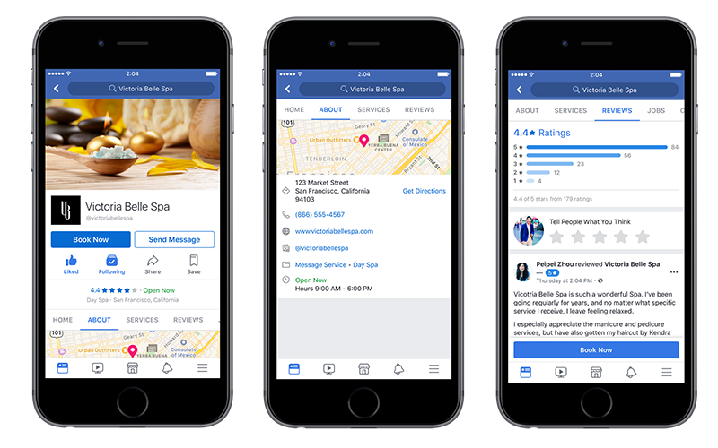

Slide 20
Building Your Mobile Presence
Provide useful information about your business
Show your brand identity with a cover photo or video.
Provide information for the About section to make it easier for customers to discover you on Facebook. It can also enhance your presence on search engines.
Enable ratings and reviews by customers to appear on your Page*
BUILD FOR MOBILE!

Slide 21
Building Your Mobile Presence
Pages have Sections
Sections let you highlight what your business offers. Depending on the Page category you chose, you can add different sections:
Promote products with a shop section
Display services with a services section

Slide 22
Building Your Mobile Presence
Pages have Sections
Shop
The Shop section is where you can showcase and sell* your products — whether it's clothing and accessories or handmade furniture — directly on Facebook. Your customers can subscribe to your Shop, or call you right from your Page. We designed this feature so you could create and manage Shops without needing to work with a third-party partner.
Also, Shops are free to use, and Facebook doesn't take a percentage of earnings.

Slide 23
Building Your Mobile Presence
Pages have Sections
Services
The Services section lets you list all of the services you offer. If you're a spa, for example, you can add a menu of treatments — such as massages and facials — and include how long each treatment is, the pricing, and more.
When deciding what information to include in this section, always keep the customer in mind. The better they understand your offerings, the more likely they are to get in contact with you.

Slide 24
Building Your Mobile Presence
Select a Page call to action (CTA)
To help customers discover your products and services, these sections display prominently on your Page, and include a call-to-action (CTA) button so you can be clear about the action you want customers to take.
Book Services
Book Now
Start Order
Get in Touch
Call Now
Sign Up
Apply Now
Contact Us
Get Quote
Send Message
Send Email

Slide 25
Q/A

Slide 26
Full Curriculum Offering
Assessment Worksheet: Setting Up For Success
Intro To Insta
Intro To Fb Pages
Intro to Stories
Intro to Insights
Fb messenger for Business
Setting Up Your Fb Shop
Intro To Fb/Insta Ads
Ig/Fb Live Video Basics
Intro To Social Media Management Tools
Let’s Learn Tik Tok Together
REELS for Instagram

